Slide 1




Adding and Subtracting
Lesson Objective: I can add and subtract fractions with unlike denominators, including mixed numbers.
@nadinegilkison
Notes:
Title of Hyperdoc-

Slide 2







5.C.4: Add and subtract fractions with unlike denominators, including mixed numbers.
Indiana
State
Standards within Hyperdoc
Explore
Explain
Apply
Create
If you see this icon, you are to type in the text box.
Notes:
Hyperlinks to each section here…
Explanation of pencil icon and others if necessary

Slide 3
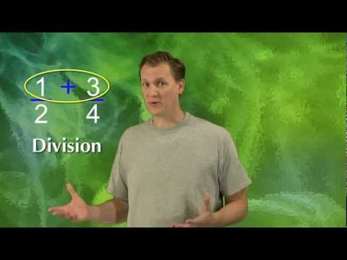
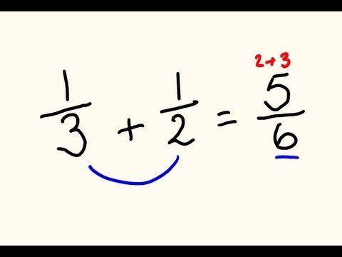
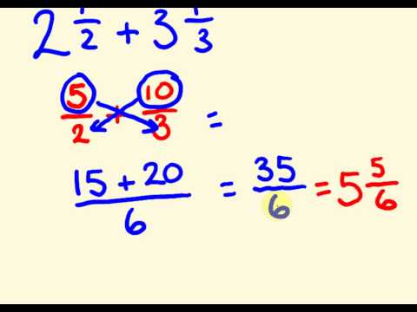
Explore
How To:
Add and Subtract Fractions with unlike denominators
How To:
Add and Subtract Mixed Numbers with unlike denominators

Slide 4

Explore
This is a real world example of subtracting mixed numbers.

Slide 5

Apply
2
1
9
3
7
3
8
5
Complete the problem above by finding common denominators and then solve. Double tap inside the boxes to enter the numbers.
Notes:
Quizizz links: https://quizizz.com/admin/quiz/58c053bd2f772c1d182743f0
https://quizizz.com/admin/quiz/57f6a5fb0fd7fc0a3cab9a28

Slide 6
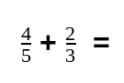
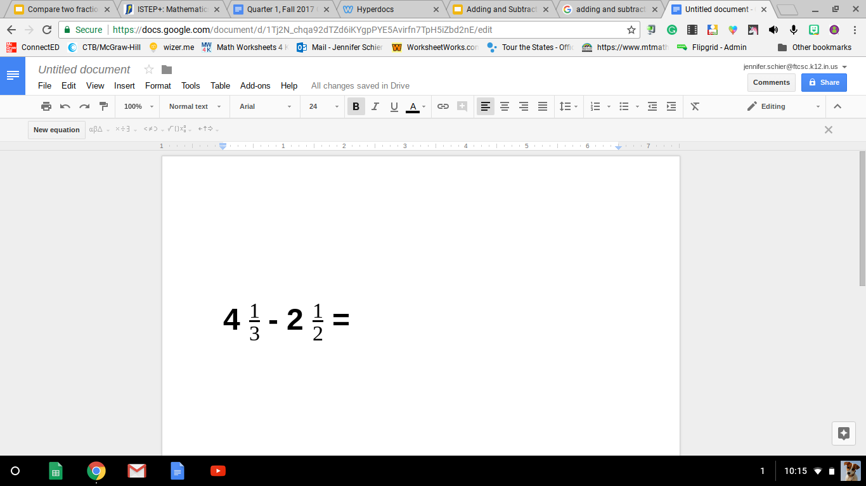
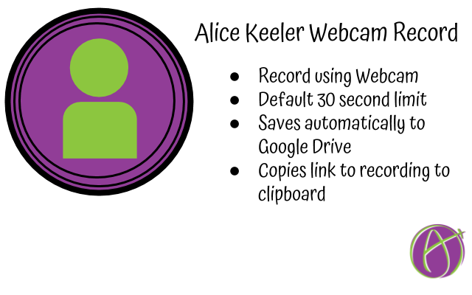

Explain
Choices:
Use flipgrid to explain how to solve the problems.
Use the Alice Keeler webcam to record how to solve the problem.
Delete these words and type how to solve this problem.
Notes:
https://docs.google.com/presentation/d/1EB-2fco29gebWRtzCVrjn4a3QrqMxxk9UvQxPe35AZE/edit#slide=id.g24323fc353_0_51 : This is the instructions for step by step Alice Keeler
Flipgrid: The teacher needs to create an account to flipgrid at flipgrid.com. Then link your topic to this slide.

Slide 7
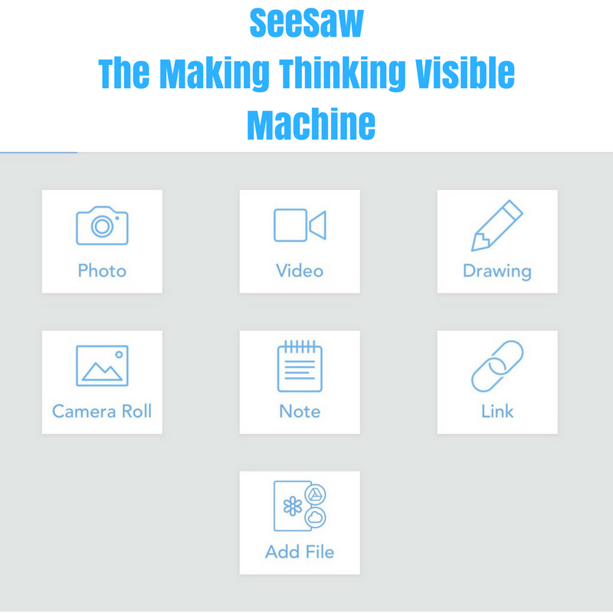

Create
Go to SEESAW:
FIRST- Create a real world story problem with a mixed fraction on a whiteboard or paper. THEN choose one of the options below.
Photo: Take a photo of your story, then record how to solve it.
Video: Take a video explaining how you solve your problem.
Notes:
Collect student work to provide feedback, and/or include a section for students to share work with an authentic audience. Have links to various types students can share their DOK… Depth of Knowledge. Padlet, Flipgrid, Recap, Google Drawings, screencastify, Seesaw… just to name a few.

Slide 8










All icons used in this template are from the Emoji One gallery, which are free to use with attribution.

Slide 9



This template was inspired by The Hyperdoc Handbook by Lisa Highfill, Kelly Hilton and Sarah Landis.
#hyperdoc
#TsGTs
Join the Facebook and Google + groups
@nadinegilkison www.fttechtips.com

